Slide 1


Customer Segments
Analysis
Not-Basic Analysts Group:
Cécile Wiederkehr, Weibin Huo, Shado Yang, Audrey Nguyen, Daniel Fu, Edward Zhang
Notes:
Hello everyone! This is The Not Basic Analysts Group. I’m Weibin. Everyone introduce themselves. Audrey and Daniel tested positive and they could not come to the class for everyone’s safe. They will join us through zoom and answer some questions when necessary.

Slide 2
Table of contents
01.
Project Goal
02.
Data Description
03.
Model Analysis
04.
Recommendations

Slide 3

Overview
Introduction:
Dataset name: Customer Personality Analysis (Kaggle)
A detailed analysis of a company’s ideal customers
Project Goal: Identify different customer segments for targeted marketing campaigns
Notes:
The goal for the project to analyze the Customer Personality data to help businesses better understand their customers and allows them to develop targeted marketing campaigns according to the specific needs, behaviors and concerns of different types of customers. This analysis can identify which customer segment is most likely to buy a product and then market the product only on that particular segment.

Slide 4
Data Description
n: 2240 lines of data
The data consists of the following customer attributes:
Customer's birth year from which the age can be derived
Customer's education level that has been divided into 2 categories: graduates and non-graduates
Customer's marital status that has been divided into 2 categories: single and non-single
Customer's yearly household income
Number of children in customer's household
Number of teenagers in customer's household
Date of customer's enrollment with the company
Number of days since customer's last purchase
Complain: 1 if the customer complained in the last 2 years, 0 otherwise
The data also gives information on how much each customer has spent on wine, fruits, meat products, fish products, sweet products and gold products in the last 2 years.
There is also an indication whether the customers have responded to 5 different campaigns.
Notes:
Let’s move to the data description, we have 2240 customers purchase information. And we have 9 mine attributes. The Birth year, where we derived the age, education level: graduates and non-graduates. Marital status: single or non-single.

Slide 5
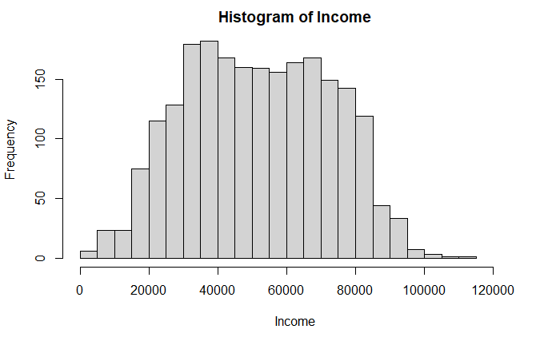
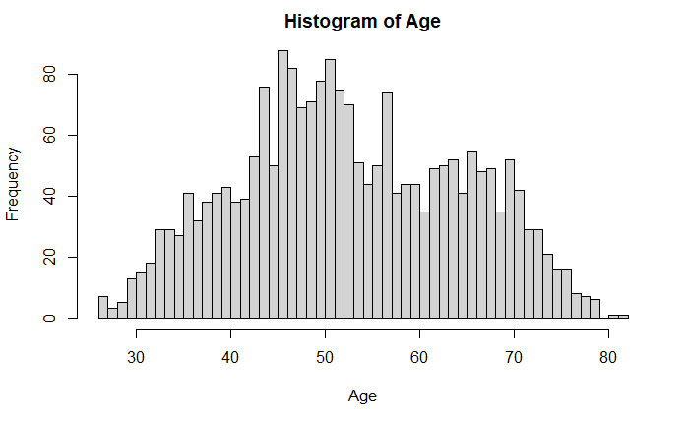
Descriptive Findings
The income ranges between $1'730 and $666'666. Only 8 customers have incomes over $125,000, the rest are normally distributed.
They're are customers with ages greater than 100 years old, which could be a mistake so we did not include them in the analysis.
Notes:
So for our analysis, we only analyzed the data that have age less than 100 years old, and income lower than 125000.

Slide 6

Models
Regression Analysis
Principal Component Analysis
K-means Analysis
Market Basket Analysis

Slide 7
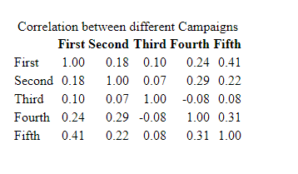
Campaigns
Overall, the most popular campaigns were the third fourth and fifth. The second campaign performed statistically significantly worse than all other campaigns.
The respondents to the first campaign correlate to the ones in the fifth campaign. There is hardly any correlation between the third campaign and the second and the third and the fourth.
Campaign | Responses
First | 142
Second | 30
Third | 163
Fourth | 164
Fifth | 161

Slide 8
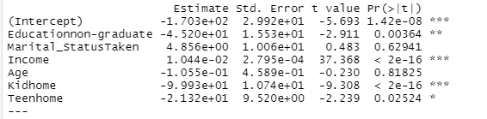
Regression
High amount spent on Wine, Gold and Meat Products make customers more likely to respond to marketing campaigns.
Customers are more likely to spend more money on wine if they do not have kids or teenagers, have a degree, and have higher income.
Customer are more likely to spend more money on Gold if they do not have a degree, have higher income, are younger and do not have kids.
Customers are more likely to spend money on Meat Products if they have higher income and no kids or teenagers.
Regression Coefficients for Amount spend on Wine

Slide 9
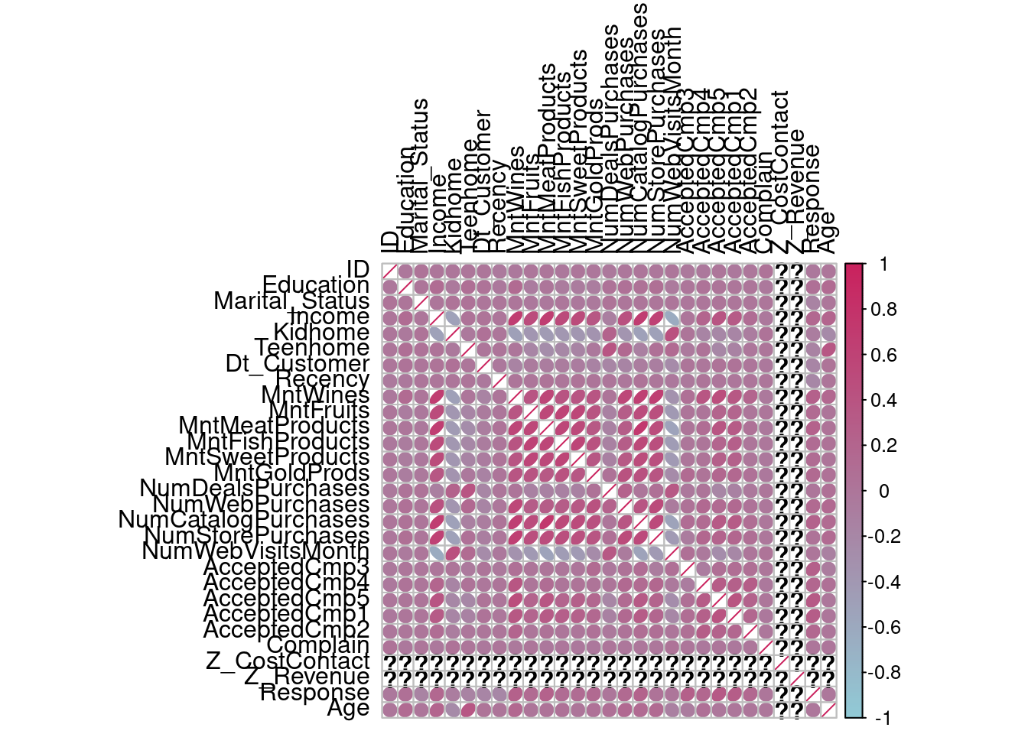
Principal Component Analysis
It allows us to summarize and to visualize the information in a data set. The data set is containing individuals/observations described by multiple inter-correlated variables. Each variable could be considered as a different dimension. If you have more than 3 variables in your data sets, it could be very difficult to visualize a multi-dimensional hyperspace.
Notes:
According to the correlation graph, there is no relationship between CostContact and Revenue. So we will remove this two factors. Color intensity and the shape of the circle are proportional to the correlation coefficients. So Positive correlations are displayed in those darker color circles.

Slide 10
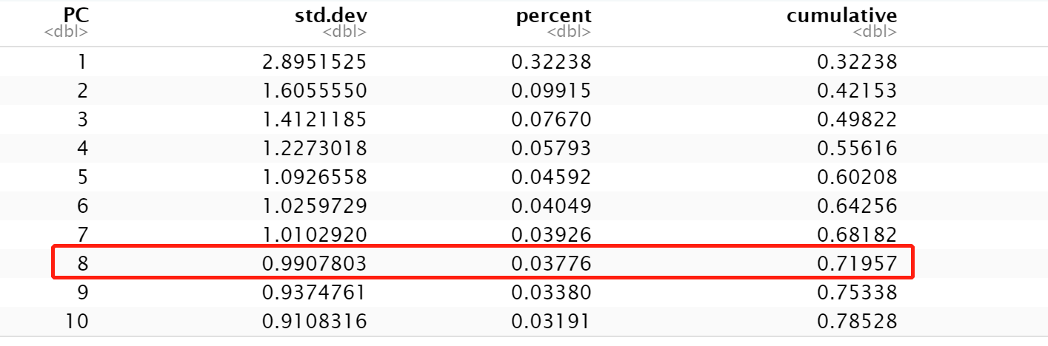
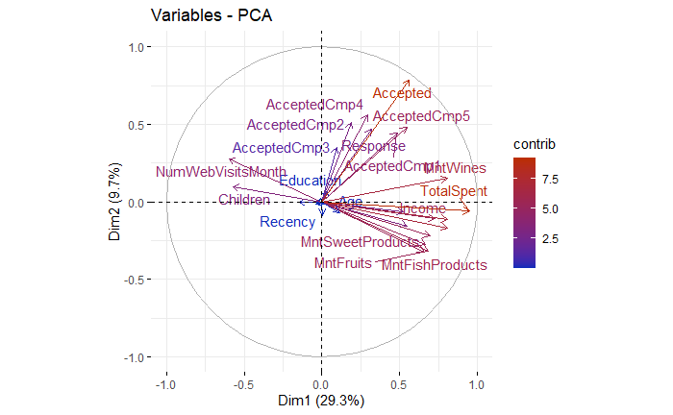
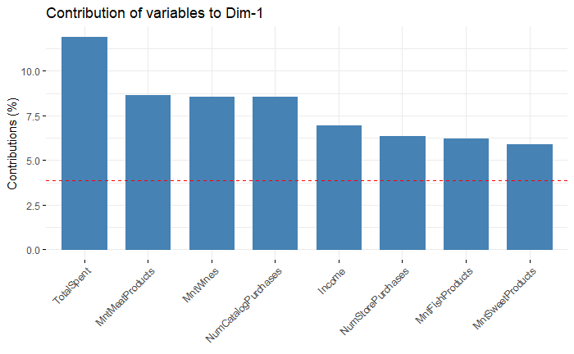
Description & Result
Number of Components: 8
Top 8 Components that contribute to the data sets: Total Spent, Meat, Wine , Catalog Purchase, Income, Store Purchase, Fish, Sweat Products
Notes:
In order to retain enough to explain a “large enough” proportion of the original data. 70% to 90% is usually used, here we choose the 70% as a standard, so we can see on the table, the top 8 components will explain about 72% of data.
At the Left lower corner: we create a factor map for the variable contributions,this is helpful to highlight the most important variables in the determination of the principal components. The labeled individuals are those with the higher contribution to the plane construction.
At RIGHT lower corner: this bar plot more derictly shows us the top 8 contribution variables to the the datasets, they are Total Spent, Meat, Wine , Catalog Purchase, Income, Store Purchase, Fish, Sweat Products

Slide 11
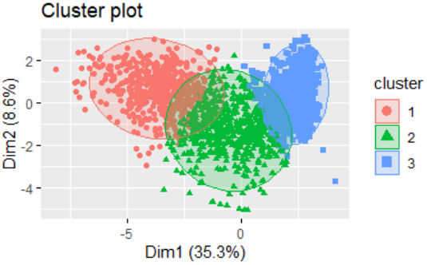
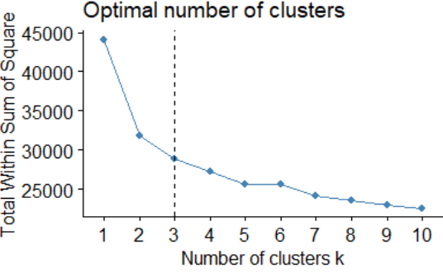
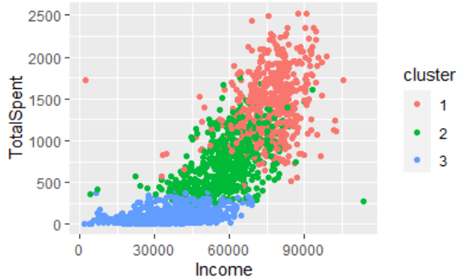
K-Means Analysis
Optimal number of clusters: 3
43.9% of the points can be explained by two components
Cluster 1 is the high value group: high income, high total spent
Notes:
The purpose of using K means model is to study the patterns and characteristic in the clusters so that we can more precisely determine which customer segments can be target for marketing campaign.
Firstly, we used elbow methods to determine the optimal number of clusters to run the analysis. As you can see from the graph on the left, the optimal number of cluster is 3. The cluster plot on the top right shows that When we split customers segments into 3, 43.9% of the point variability can be explained by two components.
Let’s see what the clusters tell us. Cluster 1 in pink color has high income and high total spent in our product, cluster 2 in green has average income and average spent, cluster 3 has below average income and low spent. We also break down the spent in different products categories such as wine, meet, fruits, and cluster 1 outperform the other 2 groups in every product category. So we considered cluster 1 as high value customer group because of the spent

Slide 12

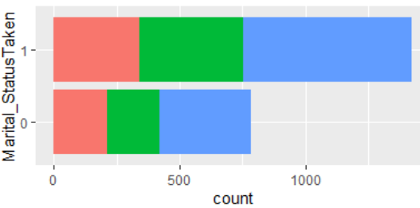
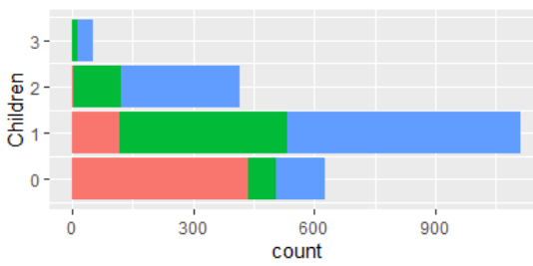
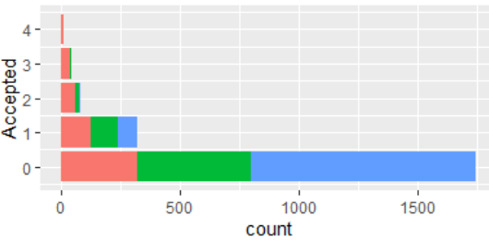
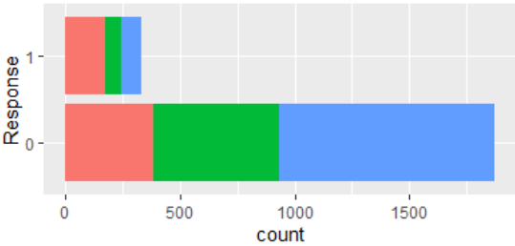
Analysis
Cluster 1 :
Income : > $60,000
Kids : 0-1
# of Campaign accepted : >=1
Response: higher response
Notes:
What other characteristic of the cluster?
Martial Status shows that: All three clusters consist of more married customers than single customers. Cluster 1 has highest single to married ratio at 57%
Children: Only a 25% of high value customers have kids and most of them only have 1 kid. On the contrast, more than 50% of the customers in other 2 groups have at least 1 kid
Acceptance numbers of campaigns: high value customer is more likely to accept campaign, and doing great job is accepting 2-4 campagins. Cluster 3 is unlikely to accept campaign
Response: 30% of customers in cluster 1 response to campaign while less than 50% of customers in other 2 groups made the response
Here we can conclude that Customers who have higher than $60,000 annual income with 0-1 kid are more likely to respond to marketing campaign and accept more than 1 campaigns on every product category.

Slide 13
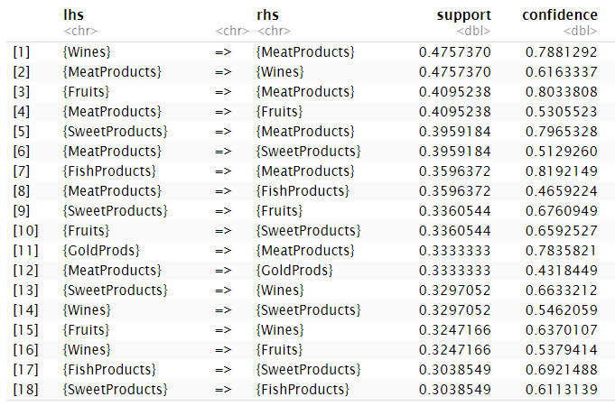
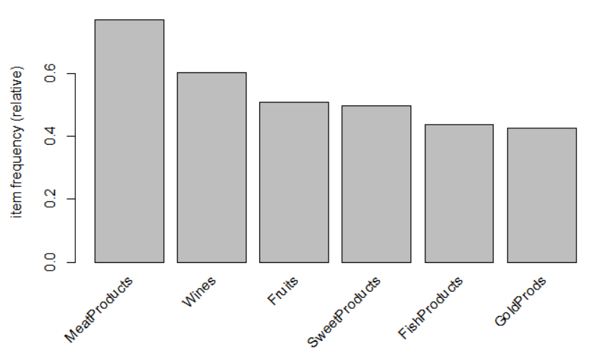
Market Basket Analysis
Wines, sweet products, fruits and meat products are always sold together.
Fish products are always sold with sweet products and meat products.
Meat products are the most common products that customers purchase.
Gold products are the least common products that customers purchase.
Notes:
Market basket analysis is a data mining technique used by retailers to increase sales by better understanding customer purchasing patterns. It works by looking for combinations of items that occur together frequently in transactions. To put it another way, it allows retailers to identify relationships between the items that people buy. If we know what people may like to buy together, we can make a better combination for our market campaign. Let’s look at the table. First, don’t be scared. It actually a really simple table to read. LHS is category A, RHS is category B. Support means how many percent of cases that category A and category B are bought together. Confidence means how many percent of cases that a person bought something in category A and he also bought category B. So let me give you a example. For the first row, we can say from our data, in 47% of cases, wines and meat products are bought together. If a person bought some wine, in 78% of cases, he bought some meat at the same time. So, if we look through the whole table, Wines, sweet products, fruits and meat products are always sold together. Fish products are always sold with sweet products and meat products. The chart at the button simply shows the frequency of items that people bought. Meat products are the most common products that customers purchase. Gold products are the least common products that customers purchase.

Slide 14
Recommendations & Impact
Recommendations:
Target customers: Income > $60,000 annually, 0-1 kids
Promote meats, wines, fruits, sweet products as a combo
Do not focus on campaign 2
Target campaign 1 and 2 responders with campaign 5
Collect data for each transaction instead of total spent in the last 2 years to make Market Basket Analysis more precise
Impact:
Save 75% on marketing by only targeting cluster 1
Limitations:
Do not know how much more customers will spend if they respond to the campaign
Total Spend influences
Notes:
After all these analysis, we would like to give the recommendations as listed below. First, we should target customers that have high income and less children, more specifically, whose income is greater than $60000 and who have 0-1 kid in their household. Second we should promote meats, wines, fruits, sweet products as a combo to increase the sales amount, since people always buy these staffs together. Third do not focus on campaign 2 . Target those campaign 1 and 2 responders with campaign 5. Last, we noticed that the total spent column negatively impact analysis’s precision a lot, so we would suggest the client to collect data for each transaction instead of total spent in the last 2 years to make Market Basket Analysis more precise.

Slide 15
Thanks!
Do you have any questions?

